Slide 1
Hard Particle Impact Model
Presented by
Sourit Saha
Summer Intern
IIT Mandi

Slide 2
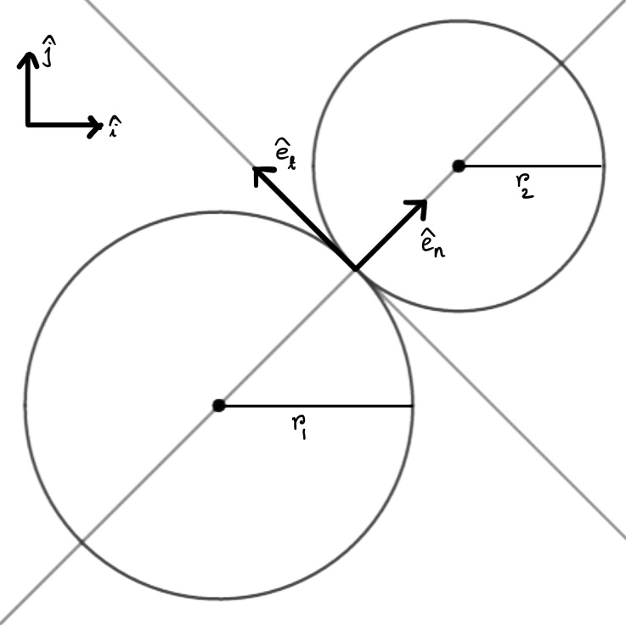
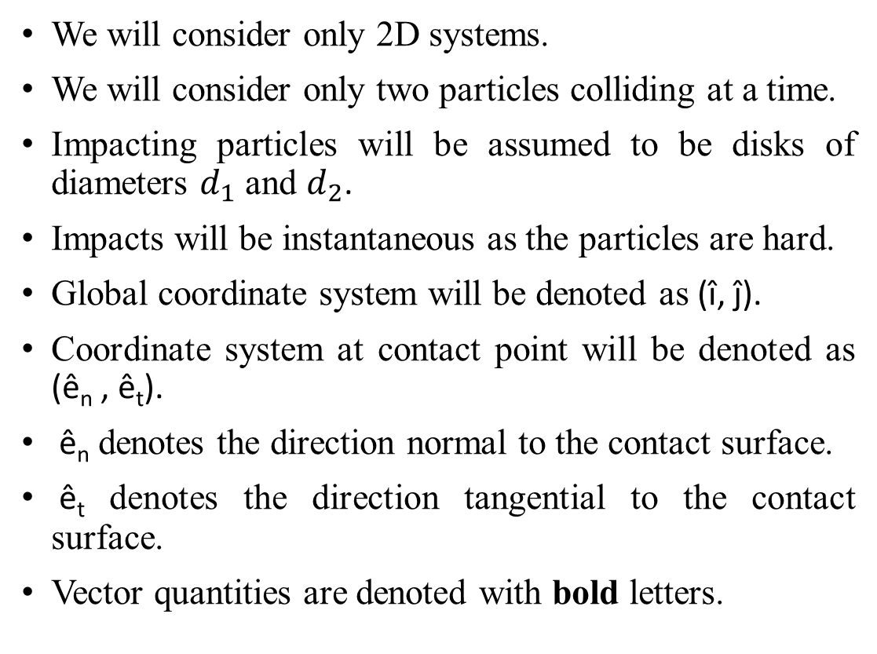


Assumptions and Notations
We will consider only 2D systems.
We will consider only two particles colliding at a time.
Impacting particles will be assumed to be disks of diameters $d_{1}$ and $d_{2}$.
Impacts will be instantaneous as the particles are hard.
Global coordinate system will be denoted as (î, ĵ).
Coordinate system at contact point will be denoted as (ê_{n} , ê_{t}).
ê_{n} denotes the direction normal to the contact surface.
ê_{t} denotes the direction tangential to the contact surface.
Vector quantities are denoted with bold letters.
$$d_{2}$$
$$d_{1}$$
Fig. 1. Hard Particle Oblique Impact

Slide 3
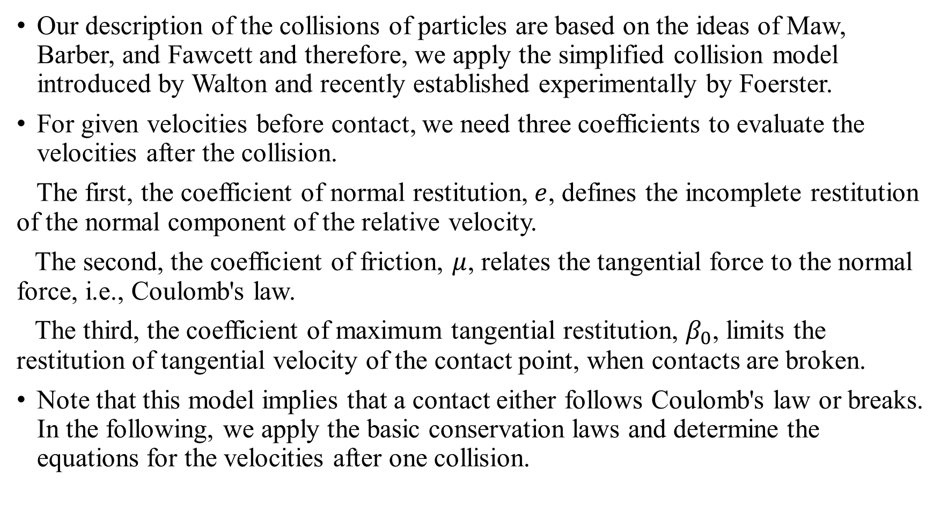
Introduction
Our description of the collisions of particles are based on the ideas of Maw, Barber, and Fawcett and therefore, we apply the simplified collision model introduced by Walton and recently established experimentally by Foerster.
For given velocities before contact, we need three coefficients to evaluate the velocities after the collision.
The first, the coefficient of normal restitution, $e$, defines the incomplete restitution of the normal component of the relative velocity.
The second, the coefficient of friction, $μ$, relates the tangential force to the normal force, i.e., Coulomb's law.
The third, the coefficient of maximum tangential restitution, $β_{0}$, limits the restitution of tangential velocity of the contact point, when contacts are broken.
Note that this model implies that a contact either follows Coulomb's law or breaks. In the following, we apply the basic conservation laws and determine the equations for the velocities after one collision.

Slide 4
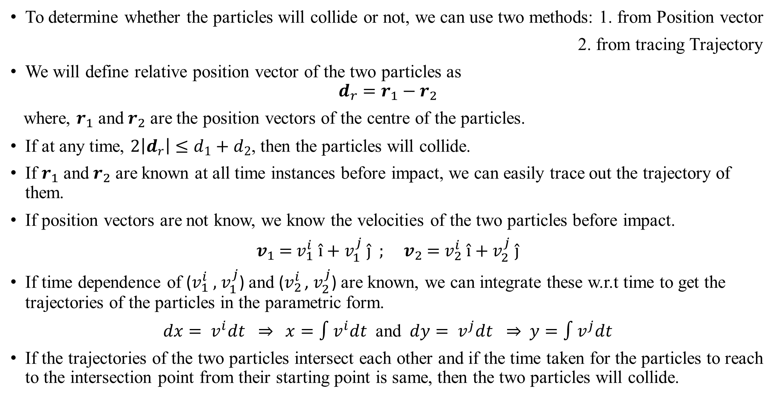
Q. Will the particles collide?
To determine whether the particles will collide or not, we can use two methods: 1. from Position vector
2. from tracing Trajectory
We will define relative position vector of the two particles as
$$d_{r}=r_{1}−r_{2}$$
where, $r_{1}$ and $r_{2}$ are the position vectors of the centre of the particles.
If at any time, $2\left|d_{r}\right|≤d_{1}+d_{2}$, then the particles will collide.
If $r_{1}$ and $r_{2}$ are known at all time instances before impact, we can easily trace out the trajectory of them.
If position vectors are not know, we know the velocities of the two particles before impact.
$v_{1}$ = $v_{1}^{i}$ î + $v_{1}^{j}$ ĵ ; $v_{2}$ = $v_{2}^{i}$ î + $v_{2}^{j}$ ĵ
If time dependence of ($v_{1}^{i}$ , $v_{1}^{j}$) and ($v_{2}^{i}$ , $v_{2}^{j}$) are known, we can integrate these w.r.t time to get the trajectories of the particles in the parametric form.
$dx= v^{i}dt ⇒$ $x=\text{∫}v^{i}dt$ and $dy= v^{j}dt ⇒$ $y=\text{∫}v^{j}dt$
If the trajectories of the two particles intersect each other and if the time taken for the particles to reach to the intersection point from their starting point is same, then the two particles will collide.

Slide 5
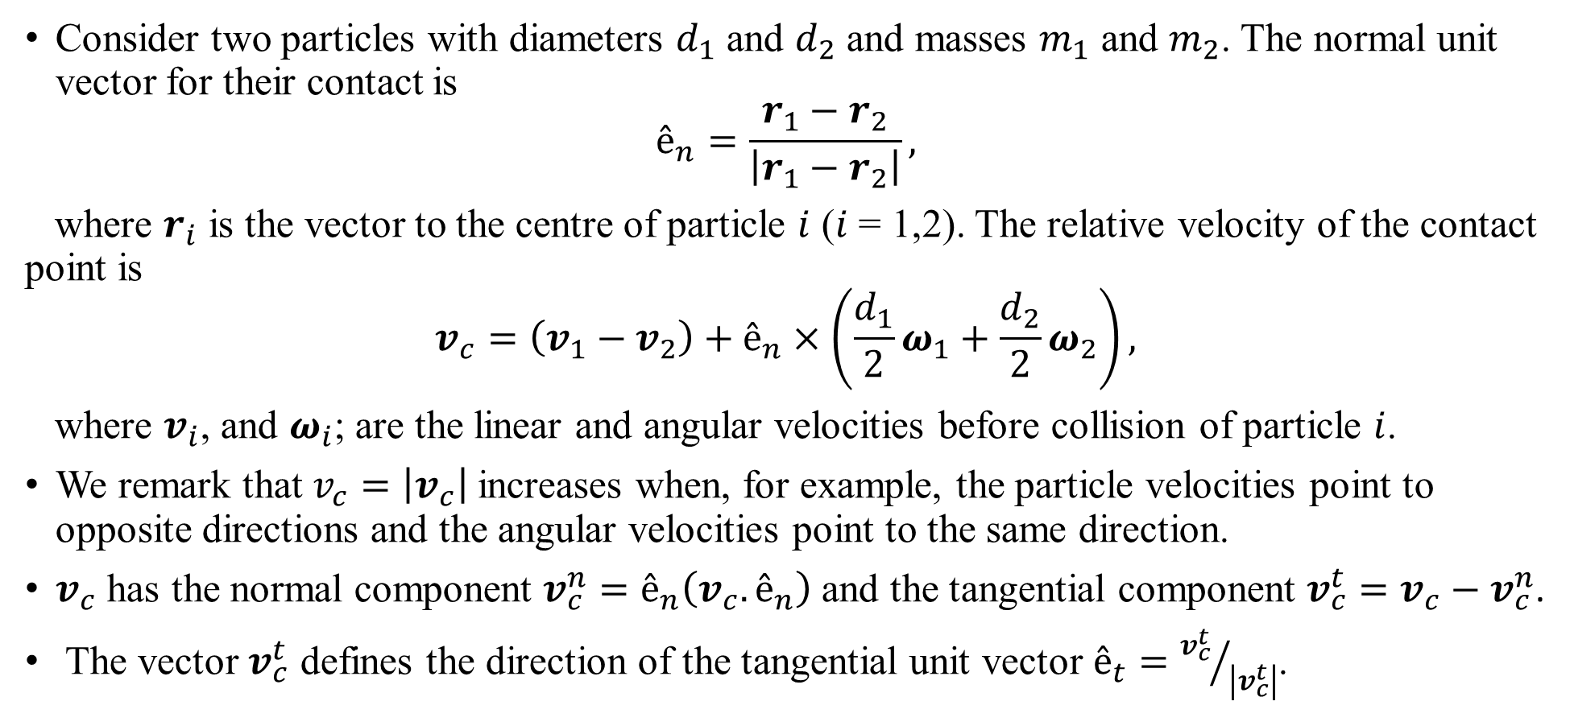
Relative Velocity of Contact Point
Consider two particles with diameters $d_{1}$ and $d_{2}$ and masses $m_{1}$ and $m_{2}$. The normal unit vector for their contact is
$$ê_{n}=\frac{r_{1}−r_{2}}{\left|r_{1}−r_{2}\right|},$$
where $r_{i}$ is the vector to the centre of particle $i$ ($i$ = 1,2). The relative velocity of the contact point is
$$v_{c}=\left(v_{1}−v_{2}\right)+ê_{n}×\left(\frac{d_{1}}{2}ω_{1}+\frac{d_{2}}{2}ω_{2}\right),$$
where $v_{i}$, and $ω_{i}$; are the linear and angular velocities before collision of particle $i$.
We remark that $v_{c}=\left|v_{c}\right|$ increases when, for example, the particle velocities point to opposite directions and the angular velocities point to the same direction.
$v_{c}$ has the normal component $v_{c}^{n}=ê_{n}\left(v_{c}.ê_{n}\right)$and the tangential component $v_{c}^{t}=v_{c}−v_{c}^{n}$.
The vector $v_{c}^{t}$ defines the direction of the tangential unit vector $ê_{t}={v_{c}^{t}}/{\left|v_{c}^{t}\right|}$.

Slide 6
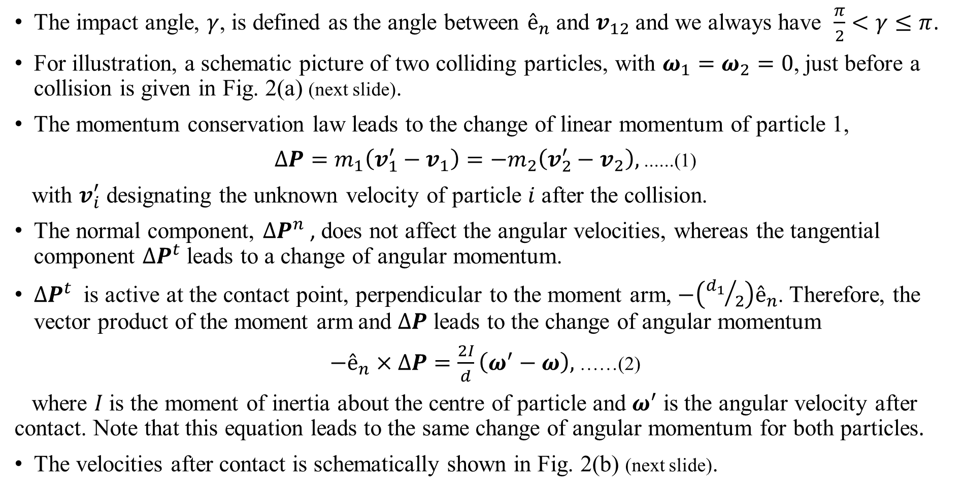

Change of Momentum: $ΔP$
The impact angle, $γ$, is defined as the angle between $ê_{n}$ and $v_{12}$ and we always have $\frac{π}{2}<γ≤π$.
For illustration, a schematic picture of two colliding particles, with $ω_{1}=ω_{2}=0$, just before a collision is given in Fig. 2(a) (next slide).
The momentum conservation law leads to the change of linear momentum of particle 1,
$ΔP=m_{1}\left(v_{1}^{′}−v_{1}\right)=−m_{2}\left(v_{2}^{′}−v_{2}\right),$ ......(1)
with $v_{i}^{′}$ designating the unknown velocity of particle $i$ after the collision.
The normal component, ${ΔP}^{n}$ , does not affect the angular velocities, whereas the tangential component ${ΔP}^{t}$ leads to a change of angular momentum.
${ΔP}^{t}$ is active at the contact point, perpendicular to the moment arm, $−\left({d_{1}}/2\right)ê_{n}$. Therefore, the vector product of the moment arm and $ΔP$ leads to the change of angular momentum
$−ê_{n}×ΔP=\frac{2I}{d}\left(ω^{′}−ω\right),$ ……(2)
where $I$ is the moment of inertia about the centre of particle and $ω^{′}$ is the angular velocity after contact. Note that this equation leads to the same change of angular momentum for both particles.
The velocities after contact is schematically shown in Fig. 2(b) (next slide).

Slide 7
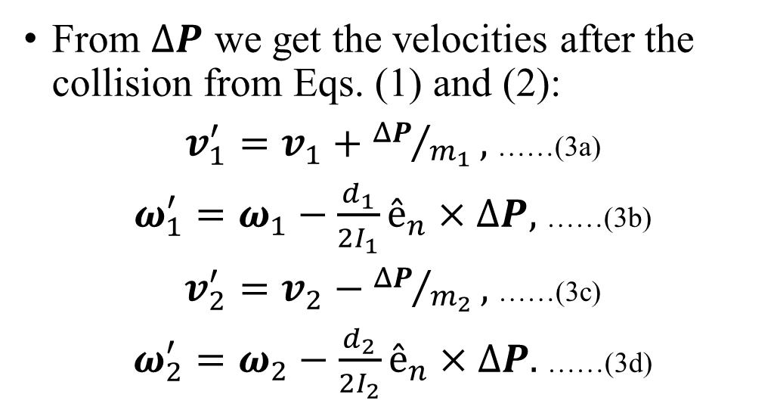
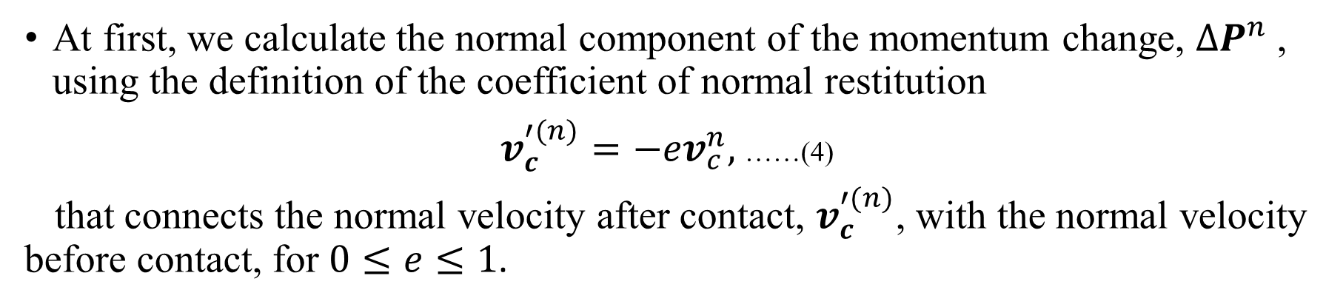
Post Impact Kinematics
From $ΔP$ we get the velocities after the collision from Eqs. (1) and (2):
$v_{1}^{′}=v_{1}+{ΔP}/{m_{1}},$ ……(3a)
$ω_{1}^{′}=ω_{1}−\frac{d_{1}}{2I_{1}}ê_{n}×ΔP,$ ……(3b)
$v_{2}^{′}=v_{2}−{ΔP}/{m_{2}},$ ……(3c)
$ω_{2}^{′}=ω_{2}−\frac{d_{2}}{2I_{2}}ê_{n}×ΔP.$ ……(3d)
Fig. 2. Typical velocities of two particles just before (a) and just after (b) collision.
At first, we calculate the normal component of the momentum change, ${ΔP}^{n}$, using the definition of the coefficient of normal restitution
$v_{c}^{′(n)}=−{ev}_{c}^{n},$ ……(4)
that connects the normal velocity after contact, $v_{c}^{′(n)}$, with the normal velocity before contact, for $0≤e≤1$.

Slide 8
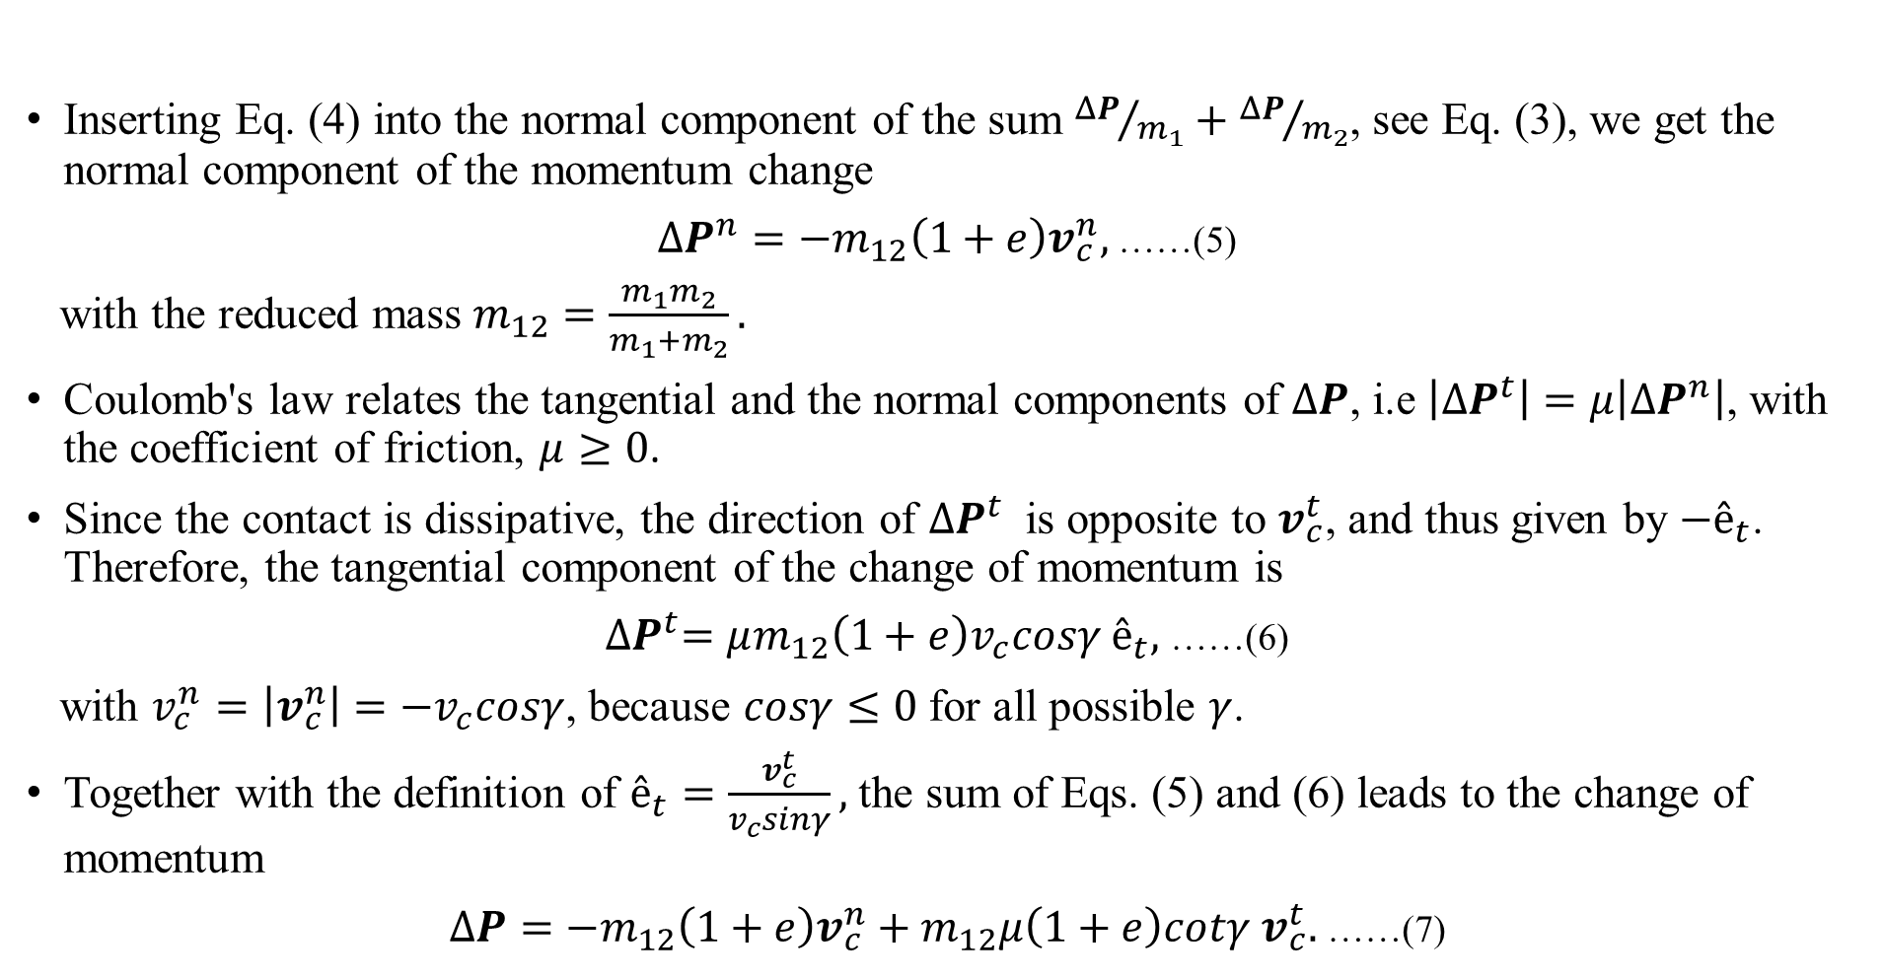
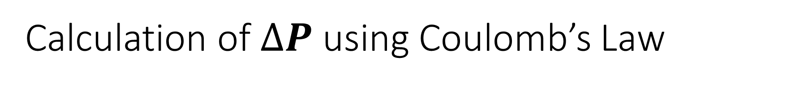
Calculation of $ΔP$ using Coulomb’s Law
Inserting Eq. (4) into the normal component of the sum ${ΔP}/{m_{1}}+{ΔP}/{m_{2}}$, see Eq. (3), we get the normal component of the momentum change
$ΔP^{n}=−m_{12}\left(1+e\right)v_{c}^{n},$ ……(5)
with the reduced mass $m_{12}=\frac{m_{1}m_{2}}{m_{1}+m_{2}}.$
Coulomb's law relates the tangential and the normal components of $ΔP$, i.e $\left|{ΔP}^{t}\right|=μ\left|{ΔP}^{n}\right|$, with the coefficient of friction, $μ≥0$.
Since the contact is dissipative, the direction of ${ΔP}^{t}$ is opposite to $v_{c}^{t}$, and thus given by ${−ê}_{t}$. Therefore, the tangential component of the change of momentum is
${∆P}^{t}=μm_{12}\left(1+e\right)v_{c}cosγ ê_{t},$ ……(6)
with $v_{c}^{n}=\left|v_{c}^{n}\right|={−v}_{c}cosγ$, because $cosγ≤0$ for all possible $γ$.
Together with the definition of $ê_{t}=\frac{v_{c}^{t}}{v_{c}sinγ},$ the sum of Eqs. (5) and (6) leads to the change of momentum
$∆P=−m_{12}\left(1+e\right)v_{c}^{n}+m_{12}μ\left(1+e\right)cotγ v_{c}^{t}.$ ……(7)

Slide 9
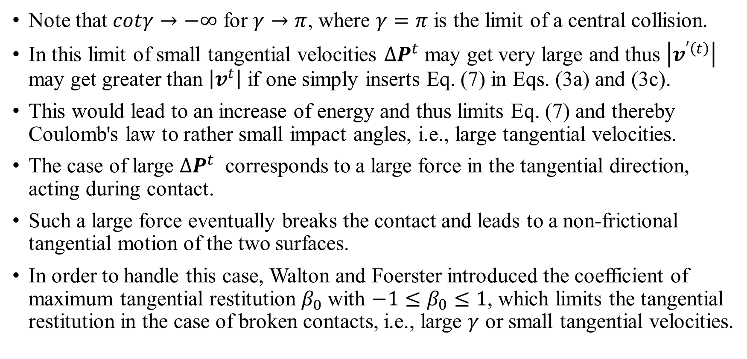
Drawbacks of Coulomb’s Law
Note that $cotγ→−∞$ for $γ→π$, where $γ=π$ is the limit of a central collision.
In this limit of small tangential velocities ${∆P}^{t}$ may get very large and thus $\left|v^{′\left(t\right)}\right|$ may get greater than $\left|v^{t}\right|$ if one simply inserts Eq. (7) in Eqs. (3a) and (3c).
This would lead to an increase of energy and thus limits Eq. (7) and thereby Coulomb's law to rather small impact angles, i.e., large tangential velocities.
The case of large ${∆P}^{t}$ corresponds to a large force in the tangential direction, acting during contact.
Such a large force eventually breaks the contact and leads to a non-frictional tangential motion of the two surfaces.
In order to handle this case, Walton and Foerster introduced the coefficient of maximum tangential restitution $β_{0}$ with $−1≤β_{0}≤1$, which limits the tangential restitution in the case of broken contacts, i.e., large $γ$ or small tangential velocities.

Slide 10
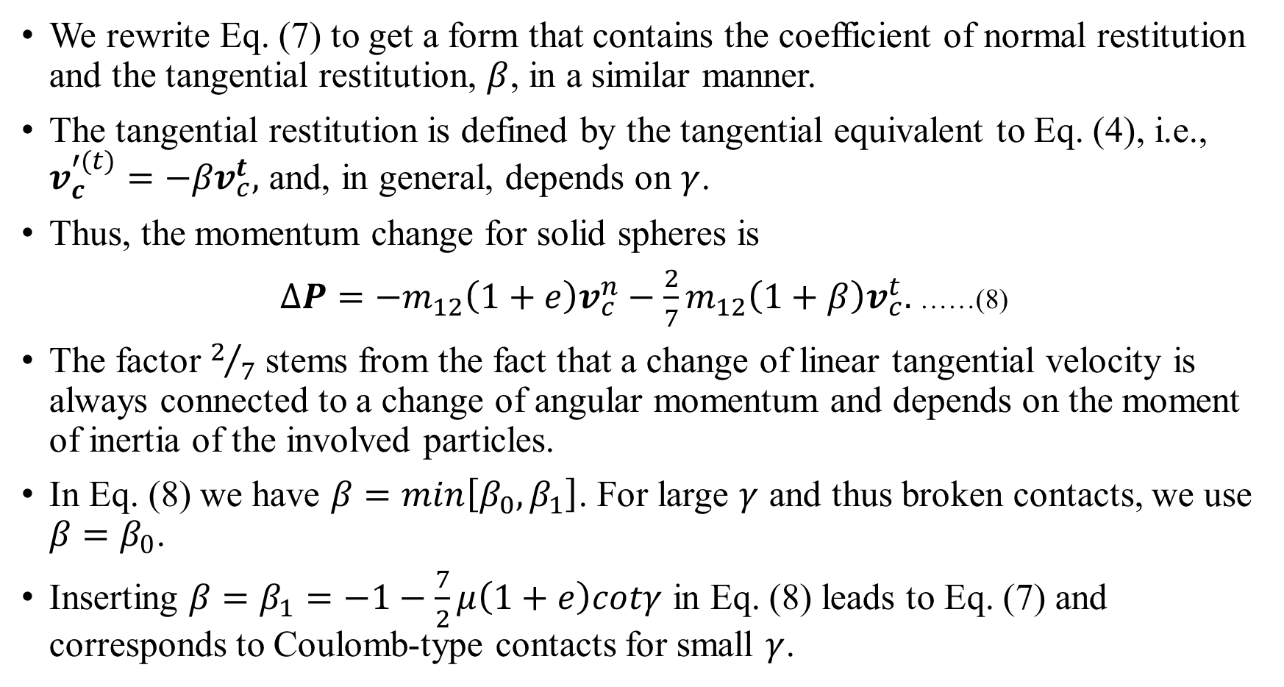
Tangential Restitution Coefficient
We rewrite Eq. (7) to get a form that contains the coefficient of normal restitution and the tangential restitution, $β$, in a similar manner.
The tangential restitution is defined by the tangential equivalent to Eq. (4), i.e., $v_{c}^{′(t)}=−{βv}_{c}^{t},$ and, in general, depends on $γ$.
Thus, the momentum change for solid spheres is
$∆P=−m_{12}\left(1+e\right)v_{c}^{n}−\frac{2}{7}m_{12}\left(1+β\right)v_{c}^{t}.$ ……(8)
The factor $2/7$ stems from the fact that a change of linear tangential velocity is always connected to a change of angular momentum and depends on the moment of inertia of the involved particles.
In Eq. (8) we have $β=min\left[β_{0},β_{1}\right]$. For large $γ$ and thus broken contacts, we use $β=β_{0}$.
Inserting $β=β_{1}=−1−\frac{7}{2}μ\left(1+e\right)cotγ$ in Eq. (8) leads to Eq. (7) and corresponds to Coulomb-type contacts for small $γ$.

Slide 11
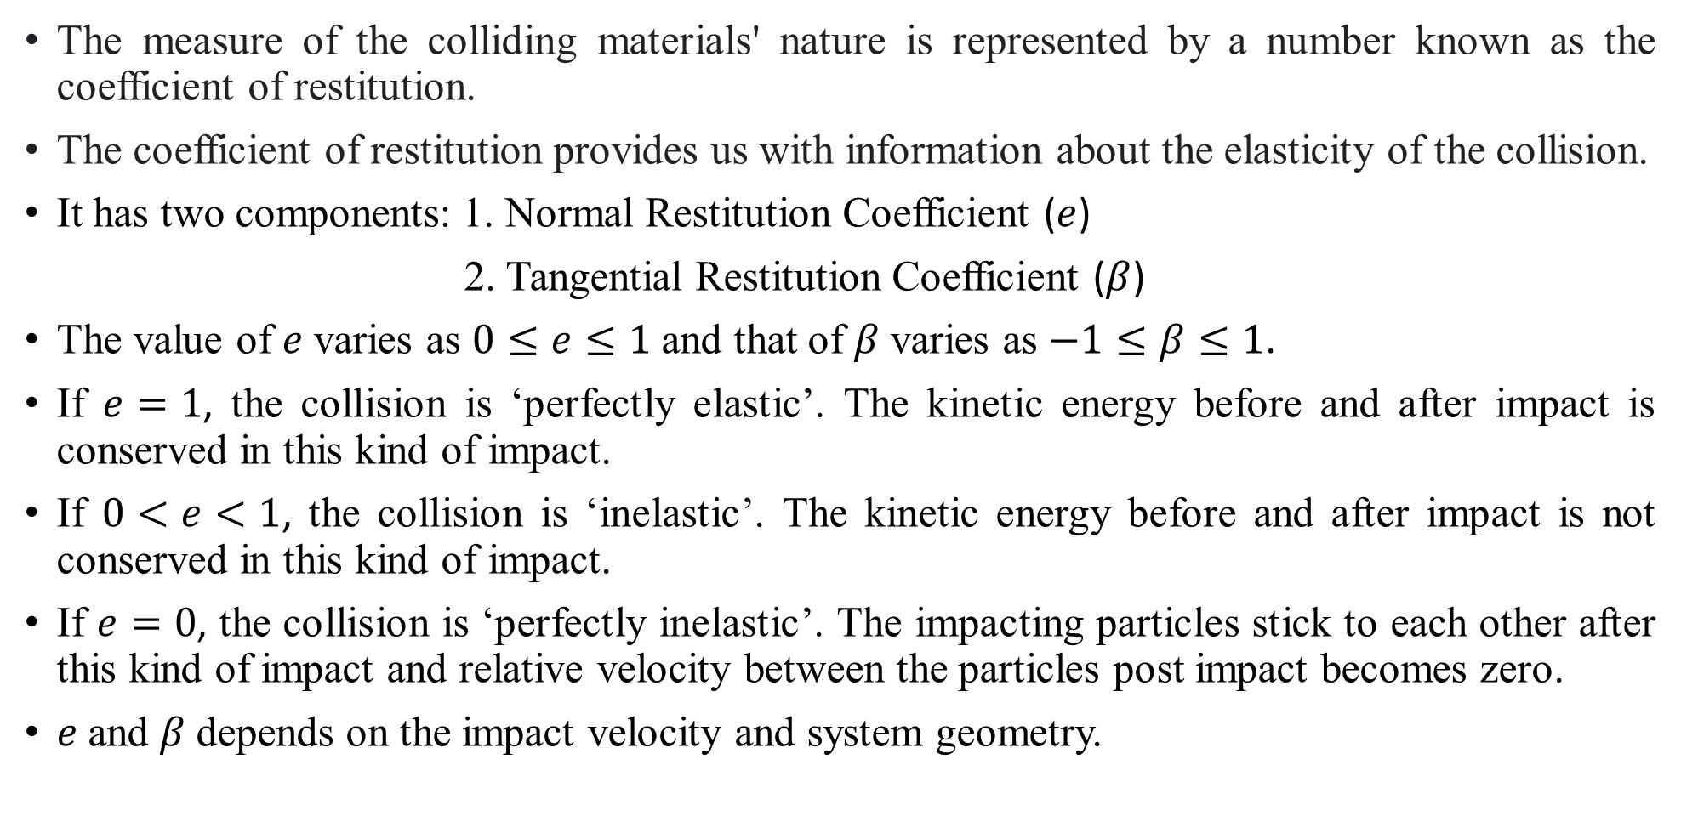
Physical significance of Restitution Coefficients
The measure of the colliding materials' nature is represented by a number known as the coefficient of restitution.
The coefficient of restitution provides us with information about the elasticity of the collision.
It has two components: 1. Normal Restitution Coefficient ($e$)
2. Tangential Restitution Coefficient ($β$)
The value of $e$ varies as $0≤e≤1$ and that of $β$ varies as $−1≤β≤1$.
If $e=1$, the collision is ‘perfectly elastic’. The kinetic energy before and after impact is conserved in this kind of impact.
If $0<e<1$, the collision is ‘inelastic’. The kinetic energy before and after impact is not conserved in this kind of impact.
If $e=0$, the collision is ‘perfectly inelastic’. The impacting particles stick to each other after this kind of impact and relative velocity between the particles post impact becomes zero.
$e$ and $β$ depends on the impact velocity and system geometry.

Slide 12
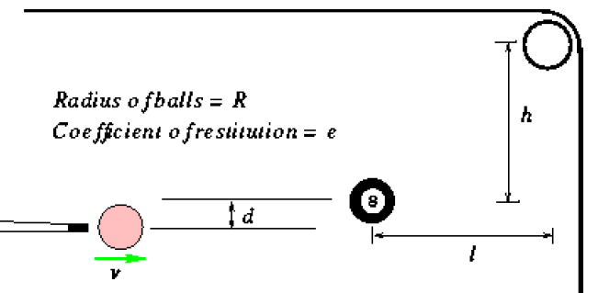
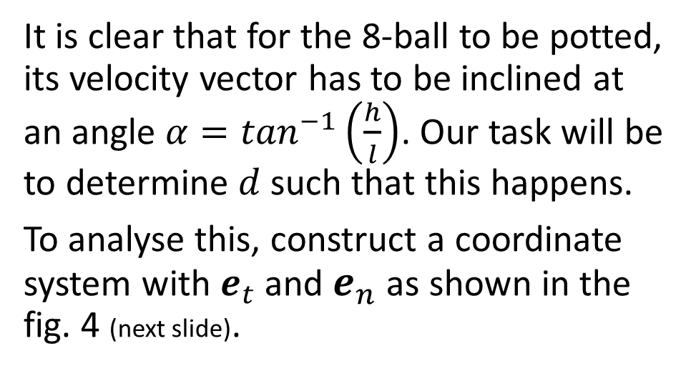
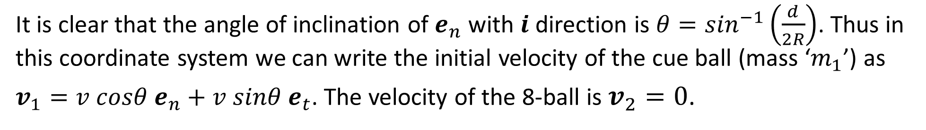
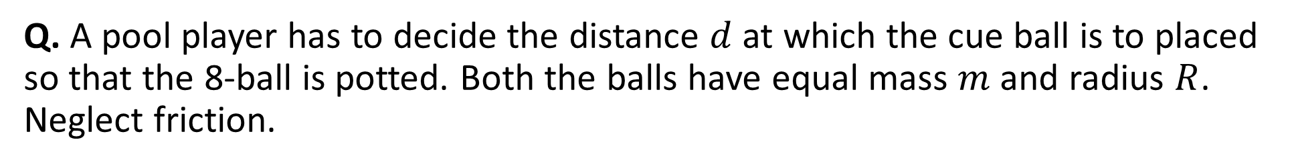
Example: Oblique Impact Numerical Problem
Q. A pool player has to decide the distance $d$ at which the cue ball is to placed so that the 8-ball is potted. Both the balls have equal mass $m$ and radius $R$. Neglect friction.
Soln.
It is clear that for the 8-ball to be potted, its velocity vector has to be inclined at an angle $α=\tan^{−1}\left(\frac{h}{l}\right)$. Our task will be to determine $d$ such that this happens.
To analyse this, construct a coordinate system with $e_{t}$ and $e_{n}$ as shown in the fig. 4 (next slide).
Fig. 3.
It is clear that the angle of inclination of $e_{n}$ with $i$ direction is $θ=\sin^{−1}\left(\frac{d}{2R}\right)$. Thus in this coordinate system we can write the initial velocity of the cue ball (mass ‘$m_{1}$’) as
$v_{1}=v cosθ e_{n}+v sinθ e_{t}$. The velocity of the 8-ball is $v_{2}=0$.

Slide 13
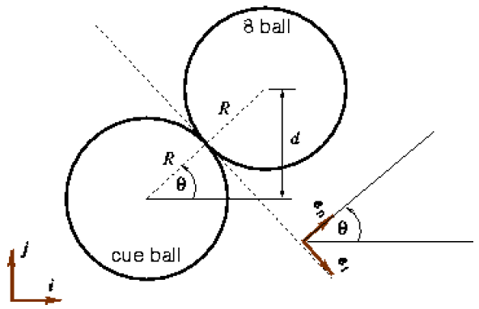
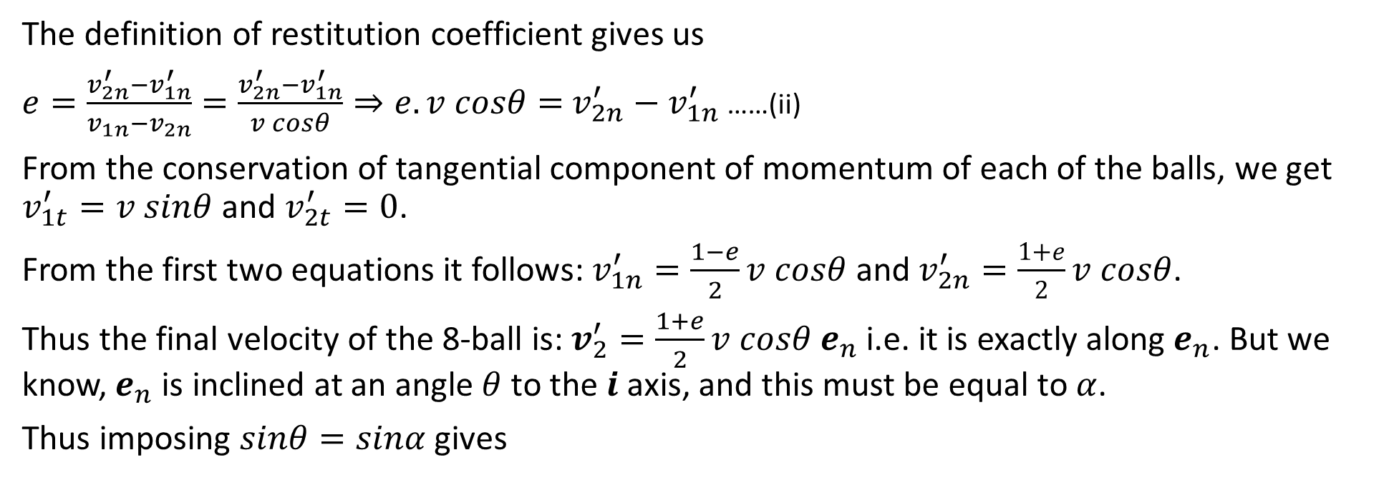

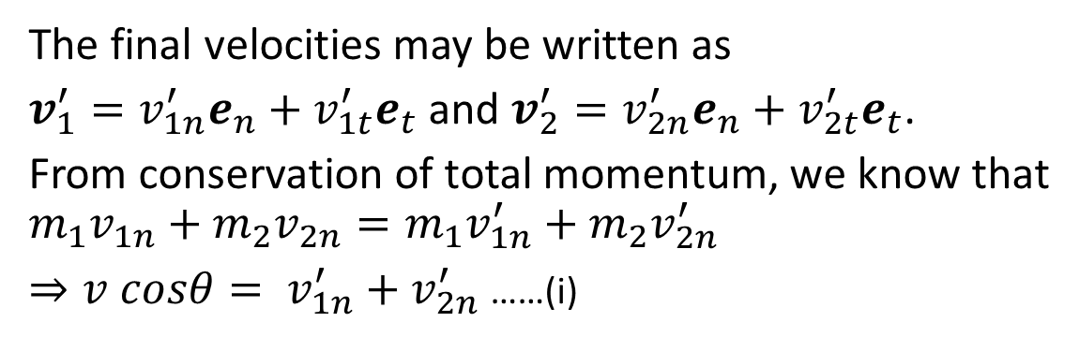
Example: Oblique Impact Numerical Problem (contd…)
The final velocities may be written as
$v_{1}^{′}=v_{1n}^{′}e_{n}+v_{1t}^{′}e_{t}$ and $v_{2}^{′}=v_{2n}^{′}e_{n}+v_{2t}^{′}e_{t}$.
From conservation of total momentum, we know that
$$m_{1}v_{1n}+m_{2}v_{2n}=m_{1}v_{1n}^{′}+m_{2}v_{2n}^{′}$$
$⇒v cosθ= v_{1n}^{′}+v_{2n}^{′}$ ……(i)
The definition of restitution coefficient gives us
$e=\frac{v_{2n}^{′}−v_{1n}^{′}}{v_{1n}−v_{2n}}=\frac{v_{2n}^{′}−v_{1n}^{′}}{v cosθ}⇒e.v cosθ=$ $v_{2n}^{′}−v_{1n}^{′}$ ……(ii)
From the conservation of tangential component of momentum of each of the balls, we get $v_{1t}^{′}=v sinθ$ and $v_{2t}^{′}=0$.
From the first two equations it follows: $v_{1n}^{′}=\frac{1−e}{2}v cosθ$ and $v_{2n}^{′}=\frac{1+e}{2}v cosθ$.
Thus the final velocity of the 8-ball is: $v_{2}^{′}=\frac{1+e}{2}v cosθ e_{n}$ i.e. it is exactly along $e_{n}$. But we know, $e_{n}$ is inclined at an angle $θ$ to the $i$ axis, and this must be equal to $α$.
Thus imposing $sinθ=sinα$ gives
Fig. 4.
$$d=\frac{2Rh}{\sqrt{l^{2}+h^{2}}}$$

Slide 14
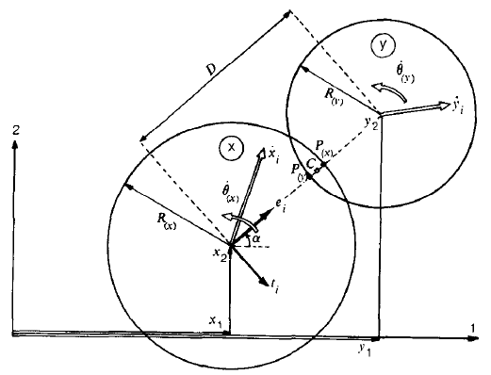
Comparison between Hard and Soft Particle Impact
Hard Particle Impact
Soft Particle Impact
In hard particle impact, the impact is instantaneous.
There is no local deformation at the contact point of the particles in hard particle impact [fig. 5(a)].
Momentum balance equations (LMB, AMB) are the primary equations to solve this problem.
In soft particle impact, the impact is not instantaneous.
Local deformation and overlapping happens at the contact of the particles in soft particle impact [fig. 5(b)].
Force-displacement equations are the primary equations to solve this problem.
Fig. 5(a). Hard Particle Impact
Fig. 5(b). Soft Particle Impact

Slide 15
Thank you!

